Slide 1
Introduction to Java for Business BU350.700.51 Spring I 2025
Java Static Methods

Slide 2
Java Methods
A method is a set of code that performs a well-defined function
This module will discuss class methods or static methods
Java also implements instance methods which will be covered later

Slide 3
Java Static Methods
A Java static (or class) method is a method that performs a task that doesn’t depend on an object.
To invoke it you just use its name & supply any required parameters.
public static void displayMessage()
{
System.out.println(“Hello World”);
}

Slide 4
Java Static Method Syntax
public, private, protected
type of value returned
same rules as variable names
access_mode static return_type method_name( arg1, arg2,… )
{
… code for method …
}
optional argument list
Methods may or may not return a value
Methods may or may not have arguments passed to them

Slide 5
Specifying a void Return Type
public static void displayMessage()
{
System.out.println( “Hello World!!” );
}
public static void performSum( int x, int y )
{
int sum = x + y;
System.out.println( sum );
}
If a method doesn’t return a value the return type must be specified as void

Slide 6
Invoking a Method
public class InvokeMethodDemo
{
public static void main( String [] args )
{
displayMessage();
displayMessage();
}
public static void displayMessage()
{
System.out.println( “Hello World!!” );
}
}

Slide 7
The Scope of Arguments & Variables
A method’s arguments and any variables defined inside the method are local to the method
Such variables can only be referenced within the method
Several different methods can use the same names for variables, but they refer to distinctly separate memory locations

Slide 8
The Scope of Arguments & Variables

Slide 9
Passing Arguments to Methods
public class PassingArgumentsDemo1
{
public static void main( String [] args )
{
displayArgs( 50, 22F );
}
public static void displayArgs( int x, float y )
{
System.out.println( “First arg is “ + x );
System.out.println( “Second arg is “ + y );
}
}

Slide 10
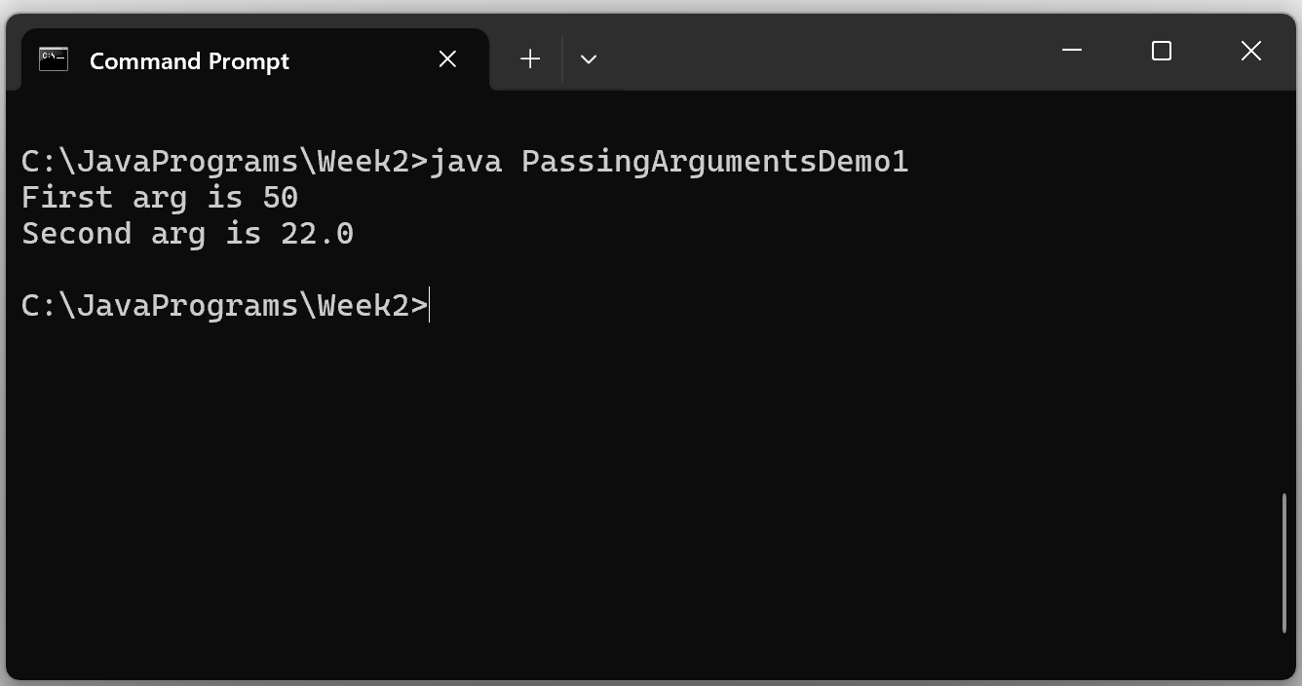
Passing Arguments to Methods
Sample Output

Slide 11
Primitive Arguments Passed By Value
public class PassingArgumentsDemo2
{
public static void main( String [] args )
{
int x = 55;
System.out.println();
changeValue( x );
System.out.println( “x in main() is “ + x );
}
public static void changeValue( int x )
{
System.out.println( “Value passed = “ + x );
x = 999;
System.out.println( “x is changeValue() is “ + x );
}
}

Slide 12
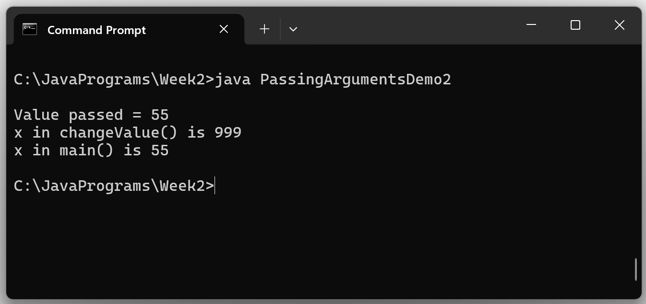
Primitive Arguments Passed By Value

Slide 13
Returning Values From Methods
Specifies that an int value will be returned
public static int addThem( int x, int y )
{
int sum = x + y;
return sum;
}
Specifies the value to be returned

Slide 14
Returning Values From Methods
public class ReturningValuesDemo1
{
public static void main( String [] args )
{
int x = 15;
int y = 27;
int z = returnSum( x, y );
System.out.println( “Sum = “ + z );
}
public static int returnSum( int x, int y )
{
int sum = x + y;
return sum;
}
}

Slide 15
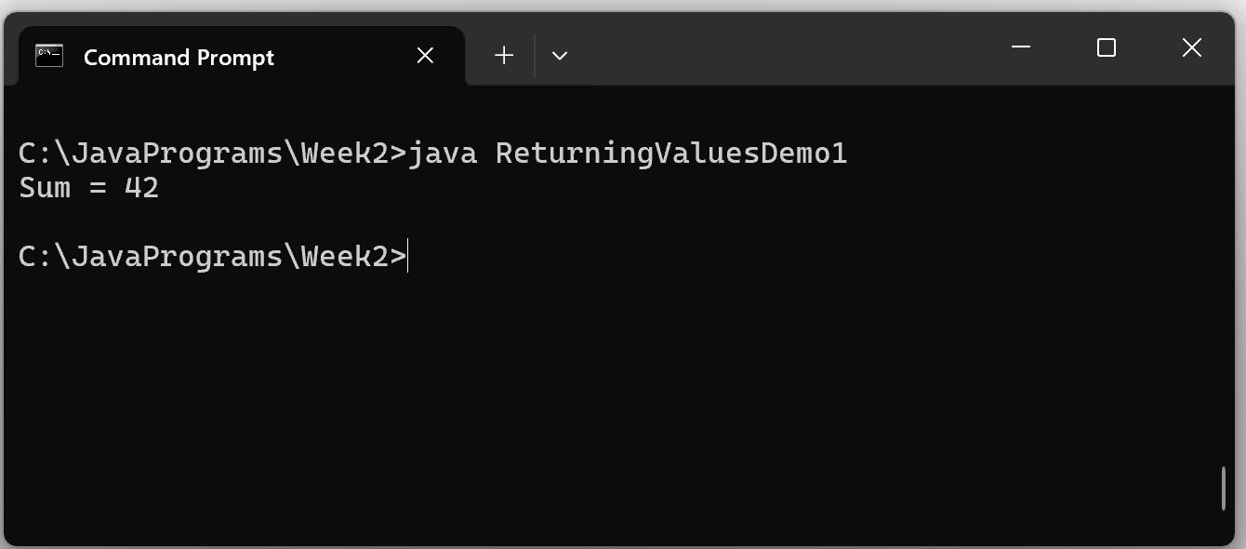
Returning Values From Methods
Program Output

Slide 16
Returning Values From Methods
public class ReturningValuesDemo2
{
public static void main( String [] args )
{
int x = 15;
int y = 27;
System.out.println( “Sum = “ + returnSum( x, y ) );
}
public static int returnSum( int x, int y )
{
int sum = x + y;
return sum;
}
}
In this example, returnSum( x, y ) was included directly in the System.out.println() argument list

Slide 17
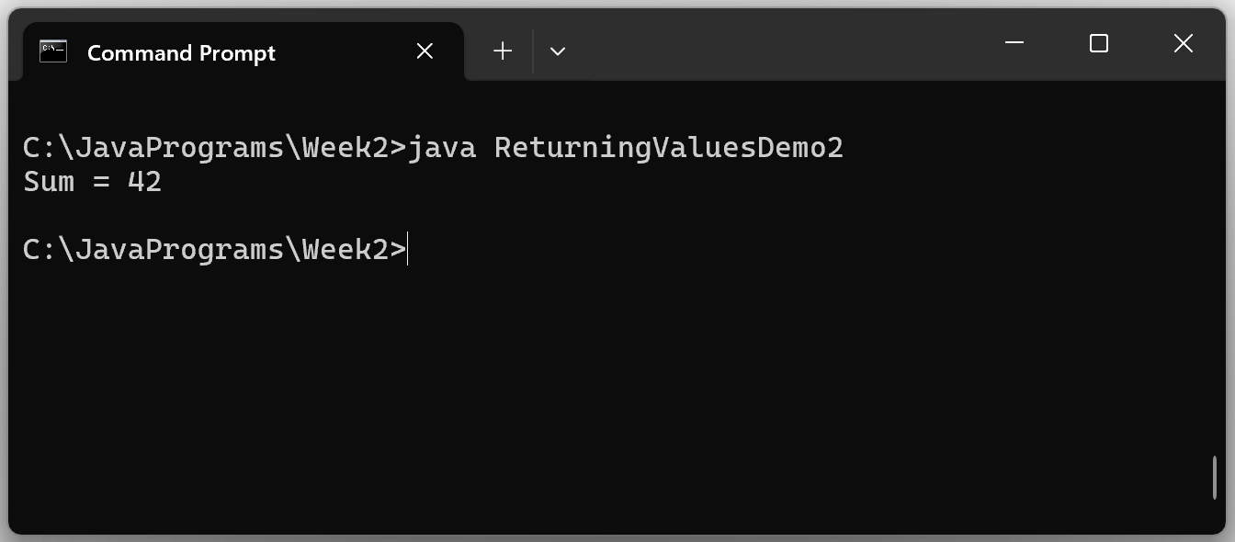
Returning Values From Methods
Program Output

Slide 18
Argument Type Checking
public class TypeCheckingDemo1
{
public static void main( String [] args )
{
int i = 50;
int j = 77;
System.out.println( “result = “ + divide( i, j ) );
}
public static float divide( float x, float y )
{
return x / y;
}
}
ok…can safely convert int to float
Argument types must be an exact match or Java must be able to safely convert
Otherwise, a program won’t compile

Slide 19
Argument Type Checking
public class TypeCheckingDemo2
{
public static void main( String [] args )
{
float i = 16.7F;
float j = 23.1F;
System.out.println( “result = “ + divide( i, j ) );
}
public static float divide( int x, int y )
{
return (float)x / y;
}
}
can’t safely convert float to int

